Slide 1

NATURAL LANGUAGE PROCESSING

Slide 2


NATURAL LANGUAGE
Refers to the language spoken by people,
i.e English, Spanish, Japanese as opposed to artificial languages like C++, Java etc.

Slide 3



Slide 4


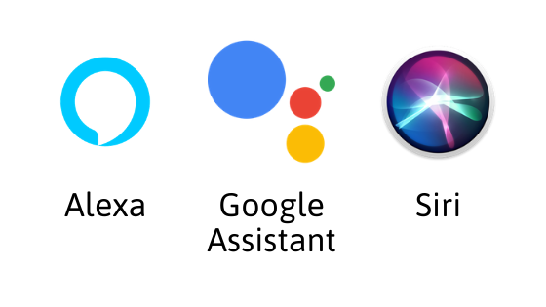


Slide 5

NATURAL LANGUAGE PROCESSING
Natural Language Processing is the science of teaching Machines how to understand the language we Human speak and write.

Slide 6



Slide 7




Slide 8
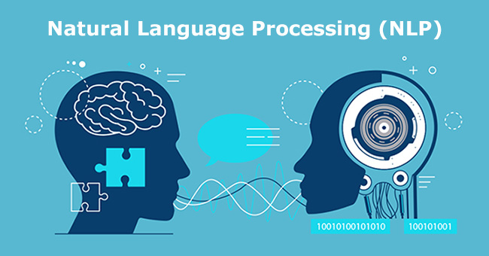

AIM OF NLP
To build intelligent system that can interact With Human Being like a Human Being.

Slide 9



Google translator

Slide 10

INPUT & OUTPUT OF NLP
NLP involves making computers to perform useful tasks with the natural languages humans use. The input and output of an NLP system can be :
Speech
Written Text

Slide 11



Slide 12
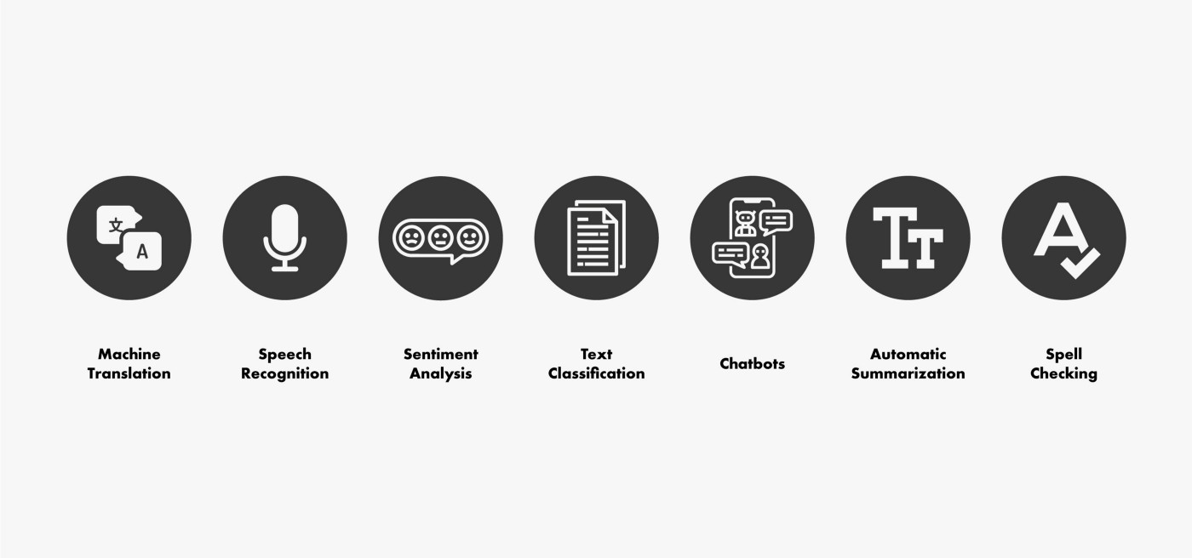
WHERE IS NLP

Slide 13
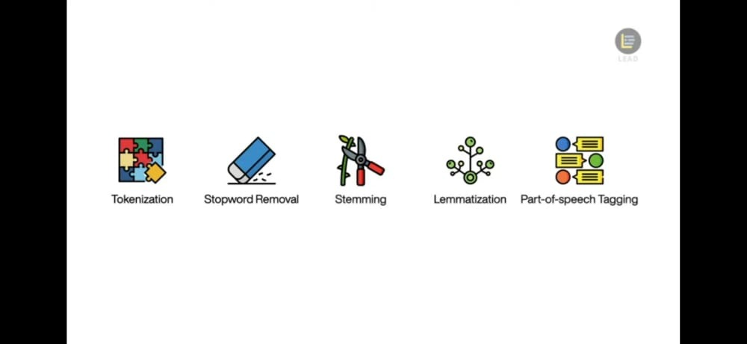
STEPS INVOLVED IN PROCESSING
TOKENIZATION STOPWORD REMOVAL STEMMING LEMMATIZATION POS TAGGING

